Slide 1
Section 5 Games Tournament/ Coach/Referee Informational Meeting Lars Sullivan Tournament Director Scott Klocko Section 5 Referee Administrator
Eric Whitener
Tournament Coach Administrator
Please mute your microphones/phones when not talking

Slide 2
Tournament Information

Slide 3
Overview
Check in
Coaches responsibilities
Referees responsibilities

Slide 4
Tournament Staff
Tournament Director – Lars Sullivan
Section Director – Tracie McCormick
Host Area Director – Michael Mays
Tournament Referee Administrator – Scott Klocko
Assistant Tournament Referee Administrator – Doug McKenzie
Local Area Referee Administrator - Josh Turpin
Tournament Safety Director – Dominique Bazar
Volunteer Coordinator – Raymond Stratton
Tournament Registrar - Jason Lanier

Slide 5
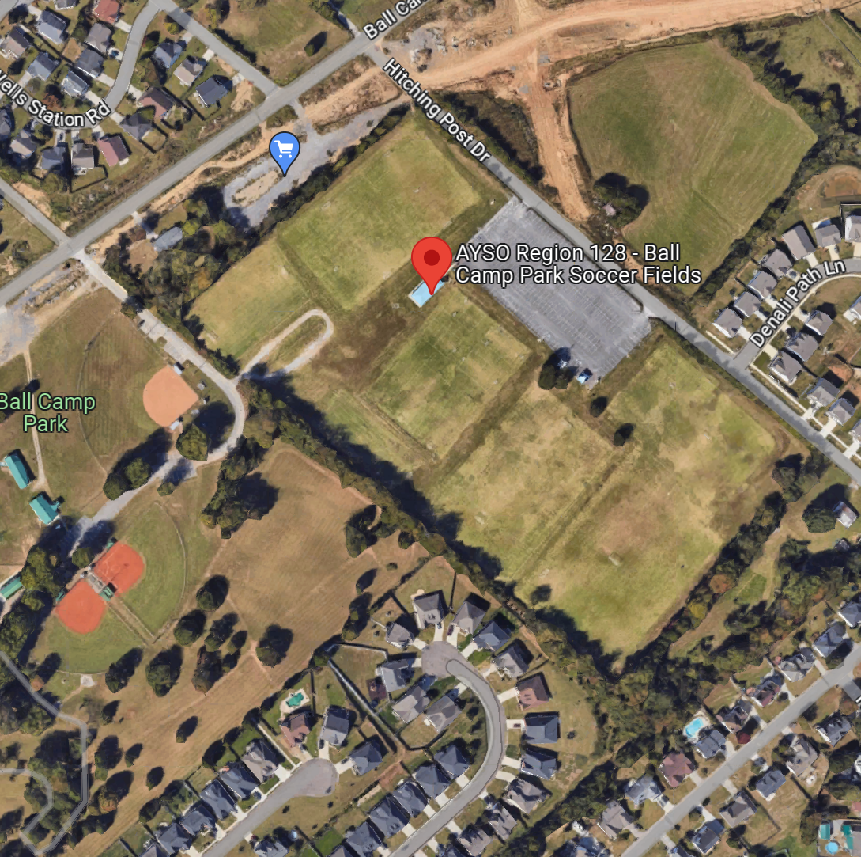
Ball Camp Soccer Fields
1831 Hitching Post Dr, Knoxville, TN 37931
Things you should know
Registration - Building
Entrance and Exit
Absolutely no parking in north side
Tents can be setup on the baseball field
Parking area – Park in designated parking areas only
NO Smoking/Vaping
NO Grills
NO Pets
Make sure that you are familiar with the rules

Slide 6
Team Check-in
The team Head Coach or designee is required to check in on Thursday June 8, 2023, 5-7 pm at The Tournament Admin building at Ball Camp Soccer fields.
The head coach or their designee must bring to Check-in the following items:
An official photo team roster printed from the Association platform, with signatures, that match the roster approved by the tournament registrar (should have already sent one to the tournament Registrar)
Ensure that Proof of date of birth for each player listed on the roster has been verified by your RC.
Bring a sample uniform with you – Jersey – make sure you are following AYSO Uniform Guidelines

Slide 7
Coach Information

Slide 8
Pool Play Matches
Division Pool Play Match Times
10U 20 minute half
12U 25 minute half
14U 30 minute half
16U 35 minute half
19U 40 minute half
*Clock runs continuously through substitutions, no added time.
10U through 14U - substitutions will be allowed as specified in the AYSO National Rules and Regulations
16U & 19U monitored Substitution is NOT allowed – 6 periods
Substitutes will be recorded on the game cards by the referee

Slide 9
Semi-Final/Final Round Matches
Division Semi & Final Match Time
10U 25 minute half
12U 30 minute half
14U 35 minute half
16U 40 minute half
19U 45 minute half
*The clock runs continuously through substitutions
*In case of a tie, there will be over time periods that will be played in their entirety.
*If match is still tied, PK’s
10U through 14U - substitutions will be allowed as specified in the AYSO National Rules and Regulations
16U & 19U monitored Substitution is NOT allowed – 6 periods
Substitutes will be recorded on the game cards by the referee

Slide 10
Substitutions
Division 10U to 14U will be substituting under the AYSO 4 standard substitution opportunities:
Approximately ½ way in the 1st half
Halftime
Approximately ½ way in the 2nd half
Injury
There will be NO monitored/free substitutions in this tournament!

Slide 11
Substitutions
16U & 19U will be substituting using 6 periods:
Approximately 1/3 way in the 1st half
Approximately 2/3 way in the 1st half
Halftime
Approximately 1/3 way in the 2nd half
Approximately 2/3 way in the 2nd half
Injury
There will be NO monitored/free substitutions in this tournament!

Slide 12
Game Format
All Teams must check in at the field 30 minutes prior to the start of the game.
All players must play at least 50% of the game. ALL players must play 75 % before ANY player plays 100 %.
At the conclusion of the game, each Head Coach must meet with the match referees and verify the final game results and sign the game card before it is submitted to the tournament scoring staff.
Coed teams will play in the boy’s divisions
Notes:
All players must play at least 50% of the game (3 quarters). ALL players must play 66 %( 4 quarters) before ANY player plays 100 %( 6 quarters).

Slide 13
Coaches
Each team must have one and only one Head Coach and one Assistant Coach.
Each Coach (Head Coach and Assistant Coach) must:
Be a registered volunteer in SportsConnect (Each coach must provide their AYSO Identification Number)
Complete Safe-Haven, SafeSport, CDC Concussion Awareness Training for the 2022/2023 soccer year (annual requirement).
Sudden Cardiac training
Have the appropriate level of AYSO Coach Training
Only the Head Coach and Assistant Coach may be present in the coaching area.
The Team Manager may be present in the coaching area if either or both of the coaches are not available.
Team Managers must have at least 10U or U10 Coach Training and CDC Concussion Awareness Training.

Slide 14
Coaches
Coaches are expected to set the example for their team in exhibiting proper AYSO behavior and Kid Zone behavior.
Coaches are expected to remain in the technical area during games and only enter the field of play as requested by the referee.
Only adults with tournament credentials will be allowed in the technical area.
No more than two adults per team will be allowed in the technical area at any given time.

Slide 15
Coaches
The teams will both be on the same side of the field where the technical area is marked.
Unless otherwise specified, spectators must be on the opposite side of the field and they are confined between the 18 and midfield line on the half of the field designated for their team.
Coaches will be expected to set a positive example for the team, and will be held responsible for the actions of their team including spectators.
All spectators must remain no closer than 3 yards from the touch line and between the 18-yard lines.

Slide 16
Coaches
Please make sure you CLEAN up trash from your bench area
Be an active member of the AYSO team
GOOD SPORTSMANSHIP
Coaches responsibility to make sure all parents are following Good Sportsmanship
Running up the score
Remember the Sun comes up on Monday
Smile and Enjoy the Weekend

Slide 17
Coaches
Things to Remember
HYDRATE! HYDRATE! HYDRATE!
Sun screen
Anything else your players will need

Slide 18
Miscellaneous
Team members shall not be allowed to practice or participate in any match with any type of cast or splint. Removal of any type of cast or splint at the field or surrounding area in order to participate shall disqualify the team member from practice or match participation.
Players shall not wear anything that is dangerous to either themselves or other players subject to the referee’s approval under Law 4 of the IFAB Laws of the Game. AYSO, in accordance with permitted modifications for youth games, allows the following:
Hair Beads and Clips Hair control devices and other adornments, such as beads, worn in the hair must meet the following criteria:
- Be securely fastened to the head.
- Do not present an increased risk to the player, teammates, or opponents.
- Flat clips less than two inches in length may be used to hold the hair in place close to the head so long as their placement on the head does not present an increased risk to the player, teammates or opponents.
- Hair charms are still considered jewelry and are not permitted.
Medical Devices If the device is needed to restrict mobility, protect an injury or support proper alignment to expedite the healing process of a temporary injury and is hard (cast, splint, etc.) then it is not allowed. If, on the other hand, the protective device is used to provide support, flexibility or enable an otherwise healthy player to function normally such as a knee brace, prosthesis, hearing aid, insulin pump/monitor, etc. then this would be allowed provided the device was sufficiently padded to prevent injury to other players. The Laws of the Game specify that “A player must not use equipment or wear anything that is dangerous.” The Referee is the sole judge of whether or not the individual item in question is permissible to wear in the game.
The Referee is the sole judge of whether or not the individual item in question is permissible to wear in the game.

Slide 19
Referee Information

Slide 20
Referee Certifications
All referees must be current registered volunteers, SafeSport, Safe Haven and CDC concussion certified.

Slide 21
Referee Certifications
12U and Lower – Regional Referees
14U – Advanced, Intermediate Referees and Experienced Regional Referees
16U & 19U – National or experienced Advanced Referees
*The venue referee administrator has the authority to override due to an assessment or other extenuating circumstance.

Slide 22
Referee Uniform
Current USSF/AYSO approved uniform must be worn during matches:
Jerseys:
Yellow (primary)
Red
Black
Blue
Green
Shorts: Black
Socks: 2 stripped
Shoes: Black
Tournament Patch

Slide 23
Referee Check-In
Referees must come to The Tournament Admin building on Thursday, June 8th from 5-7pm to collect their Section Games bag that will include their tournament patch and some goodies.
Referees must check in at Tournament Admin building each day 45 minutes prior to their first match.
Center Referees must come to “Tournament Admin building” prior to each match they officiate to get that match’s game cards.
*If doing multiple centers in a day, you must wait to get the next match’s game cards prior to that game, not all at once. This way we will not lose game cards.

Slide 24
Venue Referee Administrators
Scott Klocko – Section Referee Administrator (Lead)
Doug McKenzie – Section Director of Referee Assessment/Instruction (Assistant)

Slide 25
Pool Play Matches
*These matches are self-assigned. Please do not referee your home region’s matches. If this is done, you will be removed from the match.
Division Pool Play Match Times
10U 20 minute half
12U 25 minute half
14U 30 minute half
16U 35 minute half
19U 40 minute half
*Clock runs continuously through substitutions, no added time.

Slide 26
Semi-Final/Final Round Matches
Division Semi & Final Match Time
10U 25 minute half
12U 30 minute half
14U 35 minute half
16U 40 minute half
19U 45 minute half
*The clock runs continuously through substitutions
*In case of a tie, there will be 2 – 5 minute over time periods that will be played in their entirety.
*If match is still tied, then you will administer kicks from the mark.
*Finals are self assigned but will be monitored by tournament staff and can be reassigned if there is a need.

Slide 27
Substitutions
Division 10U to 14U will be substituting under the AYSO 4 standard substitution opportunities:
Approximately ½ way in the 1st half
Halftime
Approximately ½ way in the 2nd half
Injury
There will be NO monitored/free substitutions in this tournament!

Slide 28
Substitutions
16U & 19U will be substituting using 6 periods:
Approximately 1/3 way in the 1st half
Approximately 2/3 way in the 1st half
Halftime
Approximately 1/3 way in the 2nd half
Approximately 2/3 way in the 2nd half
Injury
There will be NO monitored/free substitutions in this tournament!

Slide 29
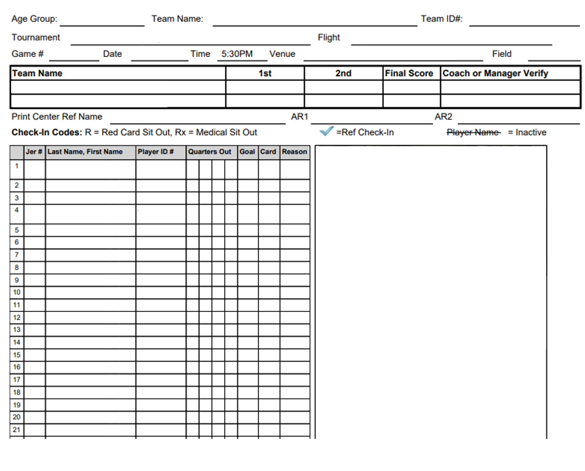
Game Cards
Referees will hold cards during the match.
They will be preprinted with the players name and number.
Keep track of score and substitutions.
Fill out back using the team name/number that is preprinted on the front of the card.
Center referee, please have your referee crew fill in their names.
Have both coaches sign the front of each card to verify the score.
Fill out Sportsmanship points on the back of the card
Referee returns cards to Soccer Central after their match.
Game card – make sure to fill the card out correctly

Slide 30
Pre game check-in
Referees are responsible for checking the teams before each game. The referee needs to make sure that every player is eligible and has the right equipment to be on the field.
Team members shall not be allowed to practice or participate in any match with any type of cast or splint. Removal of any type of cast or splint at the field or surrounding area in order to participate shall disqualify the team member from practice or match participation.
Players shall not wear anything that is dangerous to either themselves or other players subject to the referee’s approval under Law 4 of the IFAB Laws of the Game. AYSO, in accordance with permitted modifications for youth games, allows the following:
Hair Beads and Clips Hair control devices and other adornments, such as beads, worn in the hair must meet the following criteria:
- Be securely fastened to the head.
- Do not present an increased risk to the player, teammates, or opponents.
- Flat clips less than two inches in length may be used to hold the hair in place close to the head so long as their placement on the head does not present an increased risk to the player, teammates or opponents.
- Hair charms are still considered jewelry and are not permitted.
Medical Devices If the device is needed to restrict mobility, protect an injury or support proper alignment to expedite the healing process of a temporary injury and is hard (cast, splint, etc.) then it is not allowed. If, on the other hand, the protective device is used to provide support, flexibility or enable an otherwise healthy player to function normally such as a knee brace, prosthesis, hearing aid, insulin pump/monitor, etc. then this would be allowed provided the device was sufficiently padded to prevent injury to other players. The Laws of the Game specify that “A player must not use equipment or wear anything that is dangerous.” The Referee is the sole judge of whether or not the individual item in question is permissible to wear in the game.
The Referee is the sole judge of whether or not the individual item in question is permissible to wear in the game.
If there are any questions about eligibility, please contact tournament staff.

Slide 31
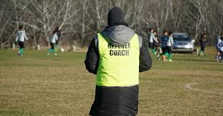
Referee Assessments
If you are looking to receive an observation for Intermediate Referee or an assessment for Advanced or National Referee, please contact Doug McKenzie at dwmckenzie@yahoo.com and sectiongames5@gmail.com to schedule.

Slide 32
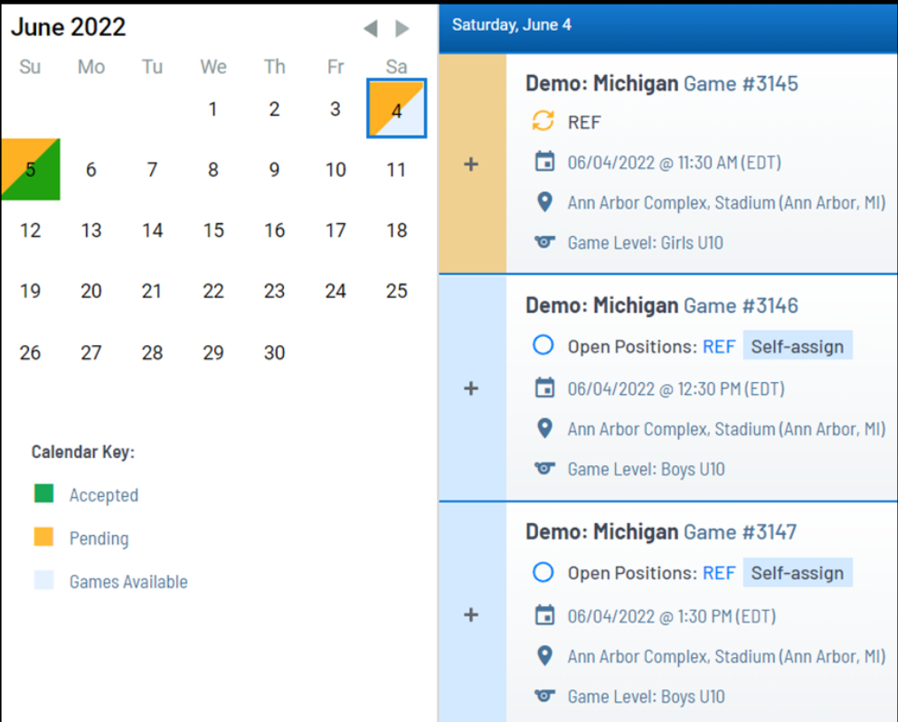
Self-Assigning
How to Self-Assign
From your Dashboard, look for DATES on the calendar with blue coloring. If you already have assignments AND there are openings available, the date square will have a split color.
Select the Date and scroll through the list. Pay attention to the Open Positions (Ref, Asst ref, Umpire) and the TIME and LOCATION of the game. Your assignments will be on the TOP of the list followed by openings in time order underneath.

Slide 33
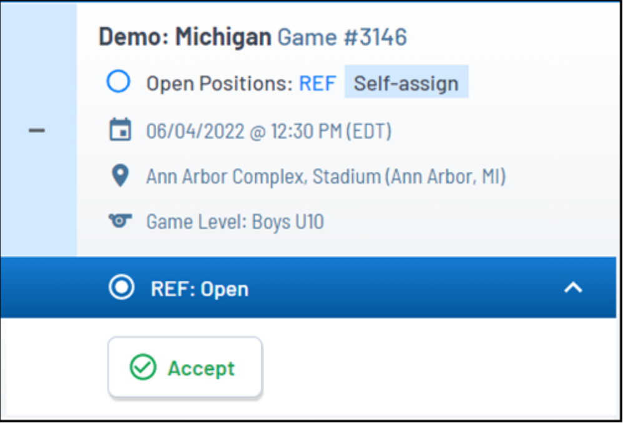
Self-Assigning
How to Self-Assign
Click the plus icon to open a Game Tile, and get crew info, team names, and directions to the field. If you still want to self-assign, select the carrot icon next to desired crew position and click “Accept”
Once accepted, your assignment will appear on the TOP of the list and you can look for more openings.

Slide 34
A BIG Thank You!
Thank you to all the coaches, referees and other volunteers to make this Section Games a huge success! We couldn’t do it without you.
Remember in AYSO, it’s about more than the game! It’s about the Kids!!

